Slide 1
Programming and Algorithm
Lab 2: Basic Programming (String, Array)

Slide 2
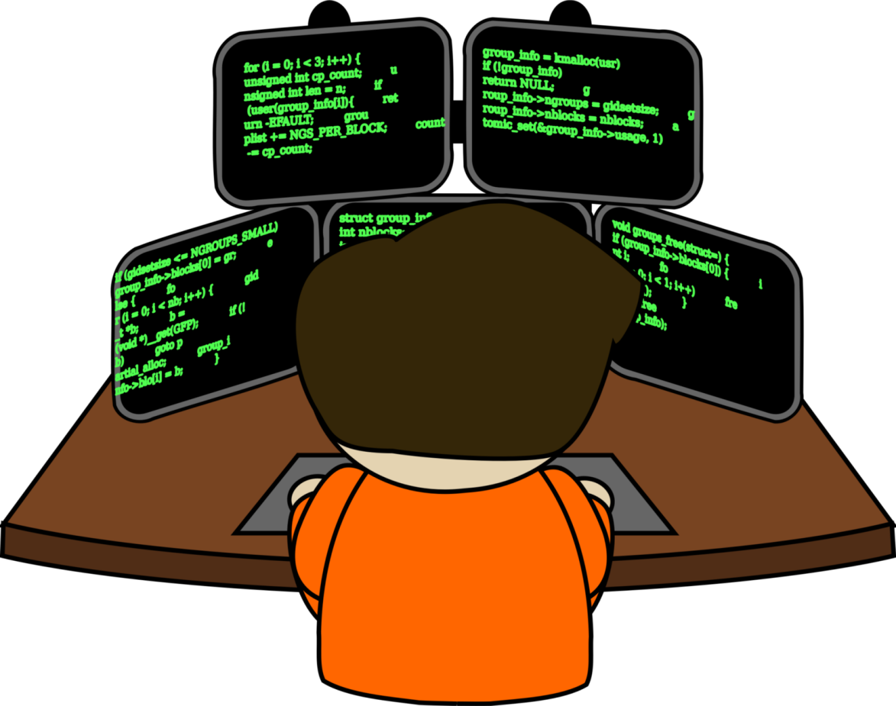

Welcome to Basic Programming Class

Slide 3

What is String?
A set of characters that may contain spaces, characters, special characters and numbers.
For instance - name, address, email e.t.c.
“Tanha Mim”
“Fahad Faysal”
“Dhanmondi,Dhaka”
“username768@gmail.com”

Slide 4
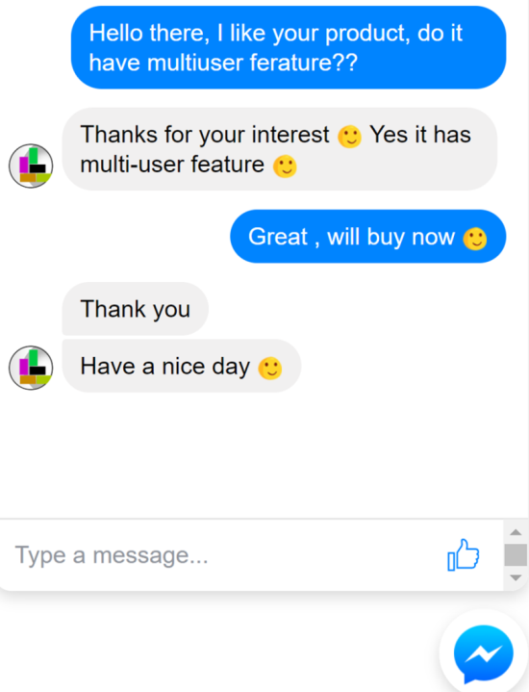
String in Programming languages
Each message is considered as a String
String employeeName = “Sharif Chowdhury”;
String emailAdress = “sharif234@gmail.com”;
String Adress = “H-23,Gulshan-2,Gulshan,Dhaka”;
Data Type
Variable Name
String

Slide 5
What is Array?
An array is a sequence of data item of homogeneous value (same type).
Two types of array:
One-dimensional array(1D)
Multi-dimensional array(2D).

Slide 6
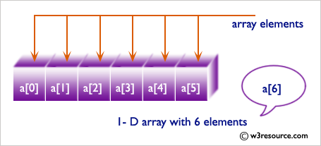
One-dimensional Array(1D)
Conceptually you can think of a one-dimensional array as a row, where elements are stored one after another.
Array1
80 | 65 | 78 | 52 | 81 | 68

Slide 7
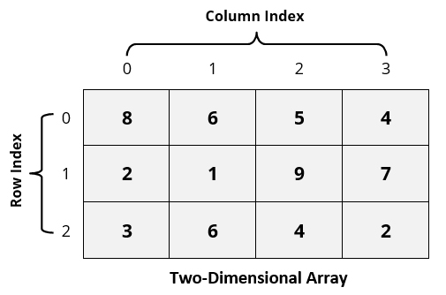
Two-dimensional Array(2D)
The two dimensional (2D) array is also
known as matrix. A matrix can be
represented as a table of rows and columns.
Array1

Slide 8
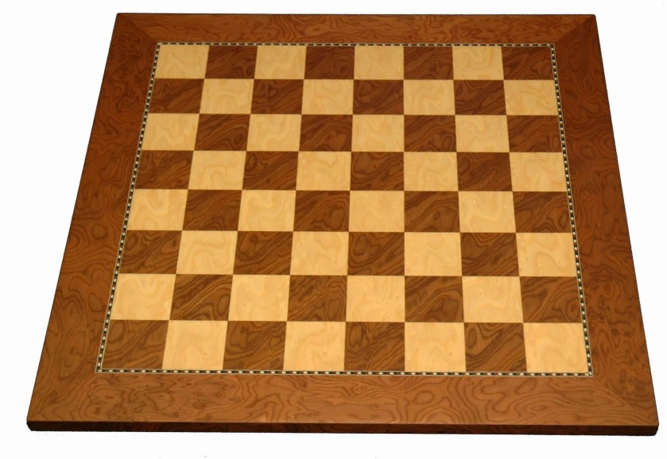
2D Array Example: Chess Board

Slide 9
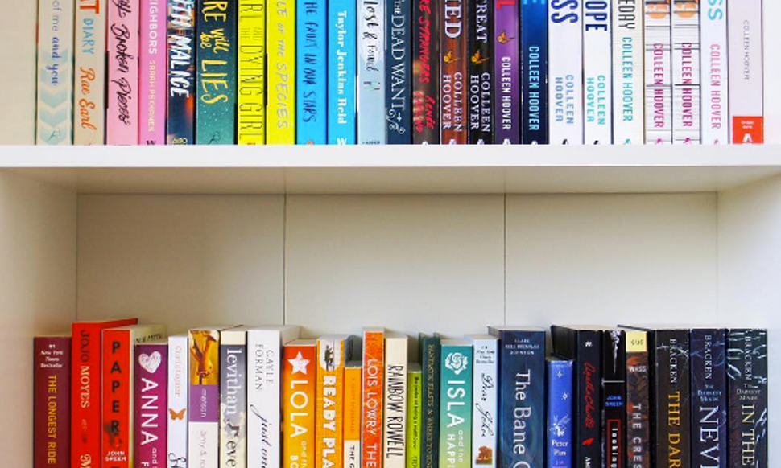
Usefulness
1D: Storing and handling same type of data or element efficiently.

Slide 10
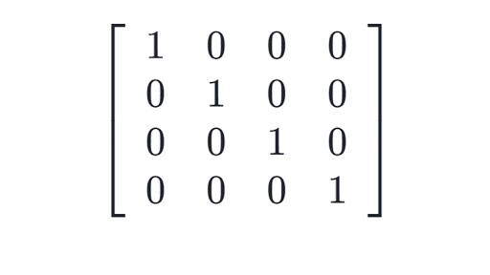
Usefulness
2D: Dependent element or data can be stored and handles efficiently. Matrix calculation is so much easy using 2D array.

Slide 11

Today’s learning:
String
Array
1d Array
2d Array
Thank You!

